Slide 1

6th Grade Math
Unit 11, Lesson 2 Evaluating Expressions with Exponents Volume 2, pg. 244

Slide 2


Benchmark
MA.6.AR.1.3
Evaluate algebraic expressions using substitution and order of operations.
volume 2, pg. 244

Slide 3
Integrated Mathematical Thinking and Reasoning Standards
MA.K12.MTR.1.1 Actively participate in effortful learning both individually and collectively.
MA.K12.MTR.4.1 Engage in discussions that reflect on the mathematical thinking of self and others.
MA.K12.MTR.5.1 Use patterns and structure to help understand and connect mathematical concepts.
volume 2, pg. 244

Slide 4

Learning Target
I can evaluate expressions that include exponents.
volume 2, pg. 244

Slide 5

Warm-Up
volume 2, pg. 245

Slide 6
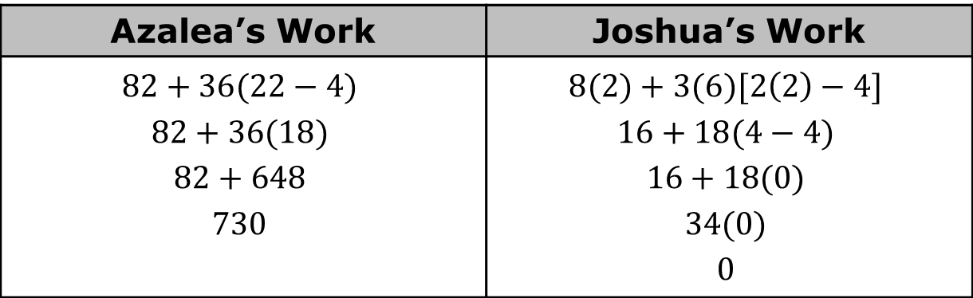

11.2.1 Warm-Up: Error Analysis
Two students made errors on yesterday’s exit ticket. Their work is shown below.
Evaluate $8a+3b(2a−4)$ for $a=2$ and $b=6$.
What error did Azalea make?
What error did Joshua make?
Azalea’s Work | Joshua’s Work
$$82+36(22−4)$$ $$82+36(18)$$ $$82+648$$ $$730$$ | $$8(2)+3(6)[2\left(2\right)−4]$$ $$16+18(4−4)$$ $$16+18(0)$$ $$34(0)$$ $$0$$
volume 2, pg. 245

Slide 7

Collaboration
volume 2, pg. 245

Slide 8

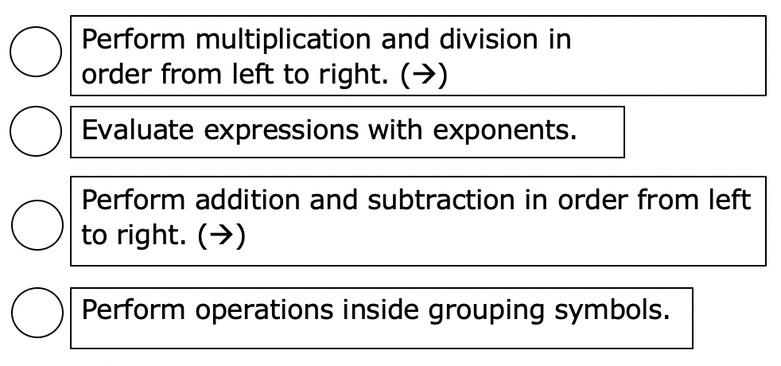
11.2.2 Collaboration: Order of Operations
Work with your partner to number each operation so that the steps for the order of operations are in the correct sequence.
volume 2, pg. 245

Slide 9

An order of operations was first noted in First Year Algebra by Webster Wells and Walter Wilson Hart. The textbook was published in 1912.
volume 2, pg. 245

Slide 10
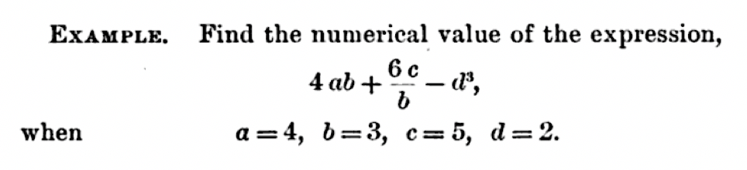
The problem below is an example from First Year Algebra.
What is the numerical value of the expression? Show your work.
Check your work with your partner.
volume 2, pg. 246

Slide 11

The work shown in the textbook is below.
What is the difference between your work and the work from the book?
An order of operations became more important when programmers needed a set of rules to program a computer to find values of numeric expressions. In 1883, Ada Lovelace described in her book about Charles Babbage's analytical engine, the first computer, that codes could be created so the device could handle letters and symbols along with numbers.
volume 2, pg. 246

Slide 12

Guided Instruction
volume 2, pg. 247

Slide 13
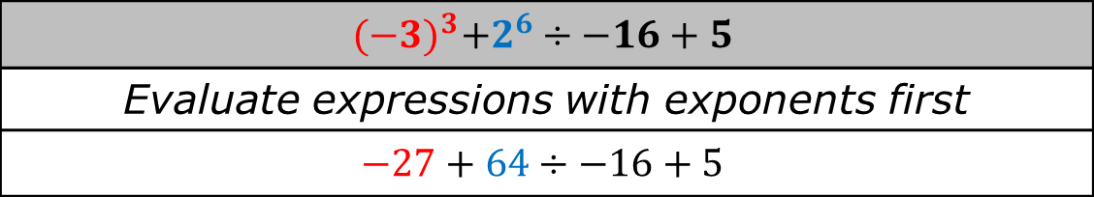
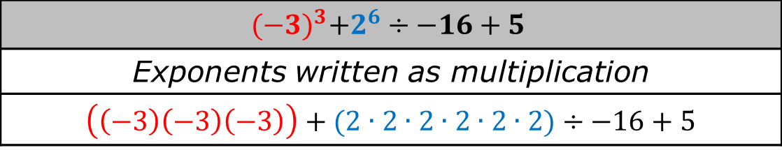
11.2.3 Guided Instruction: Evaluating Expressions with Exponents
The work in the book, First Year Algebra, showed $2^{3}$ written out as multiplication. This method can get complex as shown in the table.
$${(−3)}^{3}+2^{6}÷−16+5$$
Exponents written as multiplication
$\left(\left(−3\right)\left(−3\right)\left(−3\right)\right)+(2∙2∙2∙2∙2∙2)÷−16+5$
$${(−3)}^{3}+2^{6}÷−16+5$$
Evaluate expressions with exponents first
$$−27+64÷−16+5$$
volume 2, pg. 247

Slide 14
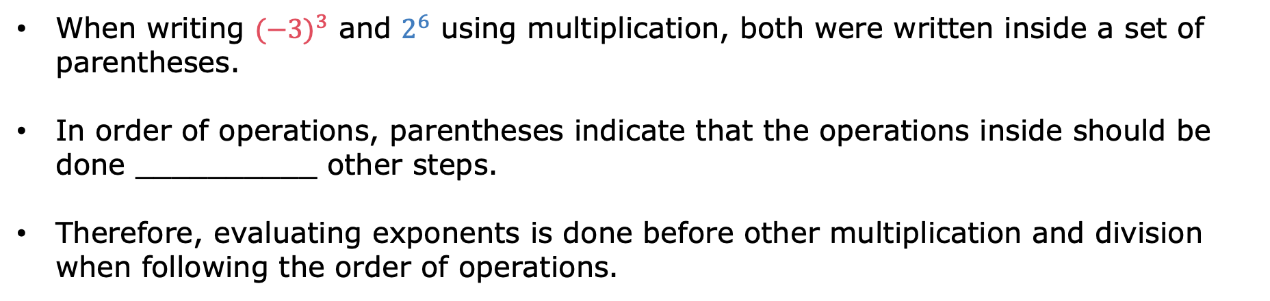
When writing ${(−3)}^{3}$ and $2^{6}$ using multiplication, both were written inside a set of parentheses.
In order of operations, parentheses indicate that the operations inside should be done __________ other steps.
Therefore, evaluating exponents is done before other multiplication and division when following the order of operations.
volume 2, pg. 247

Slide 15
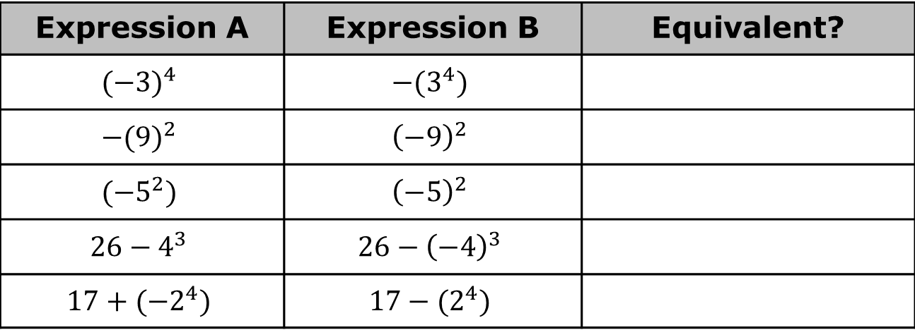

Evaluate ${(−3)}^{3}+2^{6}÷−16+5$.
Evaluate each expression, then determine if the expressions are equivalent.
Describe a strategy that can be used when evaluating expressions with exponents that include a negative sign or a subtraction sign.
Expression A | Expression B | Equivalent?
$${(−3)}^{4}$$ | $$−{(3}^{4})$$
$${−(9)}^{2}$$ | $${\left(−9\right)}^{2}$$
$${(−5}^{2})$$ | $${\left(−5\right)}^{2}$$
$$26−4^{3}$$ | $$26−{\left(−4\right)}^{3}$$
$$17+{(−2}^{4})$$ | $$17−{(2}^{4})$$
volume 2, pg. 247

Slide 16
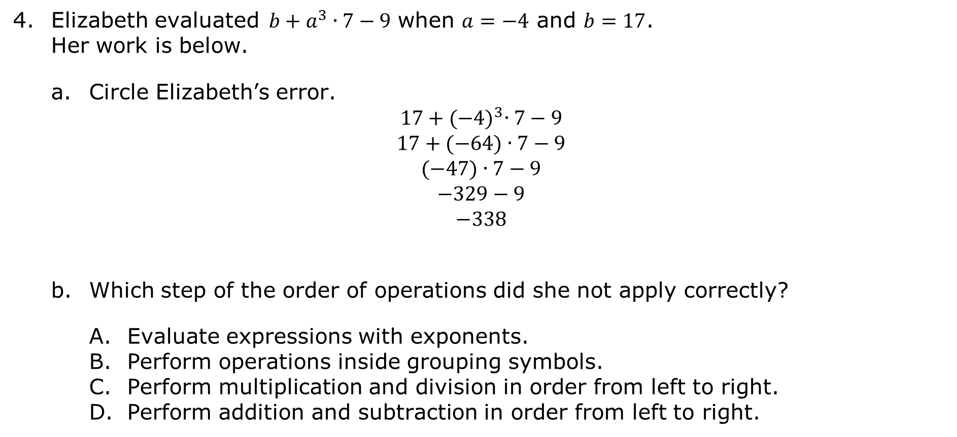
Elizabeth evaluated$b+a^{3}∙7−9$ when $a=−4$ and $b=17$. Her work is below.
Circle Elizabeth’s error.
$$17+{(−4)}^{3}∙7−9$$
$$17+(−64)∙7−9$$
$$(−47)∙7−9$$
$$−329−9$$
$$−338$$
Which step of the order of operations did she not apply correctly?
Evaluate expressions with exponents.
Perform operations inside grouping symbols.
Perform multiplication and division in order from left to right.
Perform addition and subtraction in order from left to right.
volume 2, pg. 248

Slide 17

The order of performing computations is first to work within grouping symbols using the order of operations. Then, simplify terms with exponents. Next, while reading from left to right, perform multiplication and division in the order in which it appears. Finally, while reading from left to right, perform addition and subtraction in the order in which it appears.
volume 2, pg. 248

Slide 18

Try It
volume 2, pg. 248

Slide 19

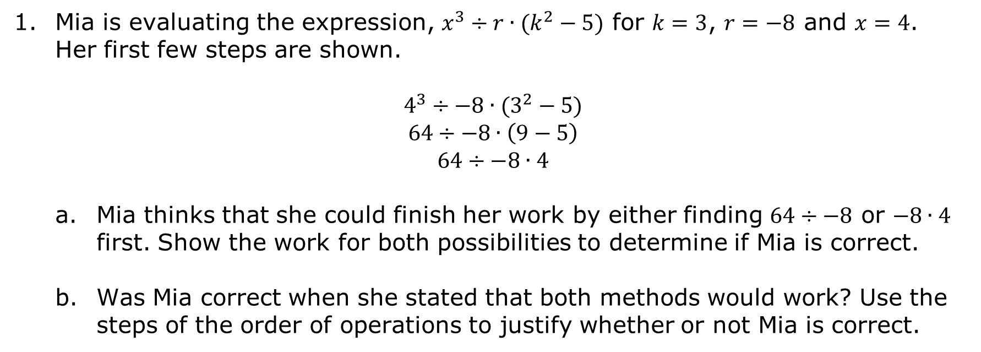
11.2.4 Try It: Discovering the Importance of Left to Right
Mia is evaluating the expression, $x^{3}÷r∙(k^{2}−5)$ for $k=3$, $r=−8$ and $x=4$. Her first few steps are shown.
$$4^{3}÷−8∙(3^{2}−5)$$
$$64÷−8∙\left(9−5\right)$$
$$64÷−8∙4$$
Mia thinks that she could finish her work by either finding $64÷−8$ or $−8∙4$ first. Show the work for both possibilities to determine if Mia is correct.
Was Mia correct when she stated that both methods would work? Use the steps of the order of operations to justify whether or not Mia is correct.
volume 2, pg. 248

Slide 20
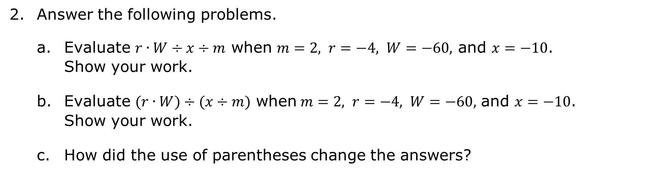
Answer the following problems.
Evaluate $r∙W÷x÷m$ when $m=2, r=−4, W=−60,$ and $x=−10$. Show your work.
Evaluate $(r∙W)÷(x÷m$) when$m=2, r=−4, W=−60,$ and $x=−10$. Show your work.
How did the use of parentheses change the answers?
volume 2, pg. 249

Slide 21
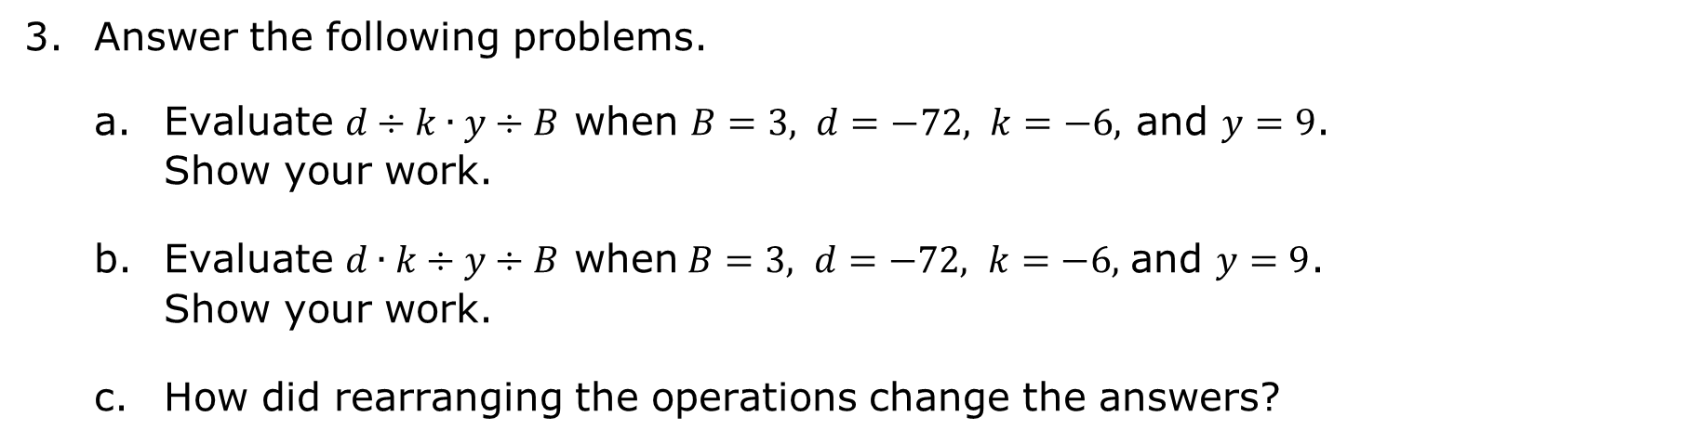
Answer the following problems.
Evaluate $d÷k∙y÷B$ when $B=3, d=−72, k=−6,$ and $y=9$. Show your work.
Evaluate $d∙k÷y÷B$ when$B=3, d=−72, k=−6,$ and $y=9$. Show your work.
How did rearranging the operations change the answers?
volume 2, pg. 249

Slide 22

Your Turn
volume 2, pg. 250

Slide 23
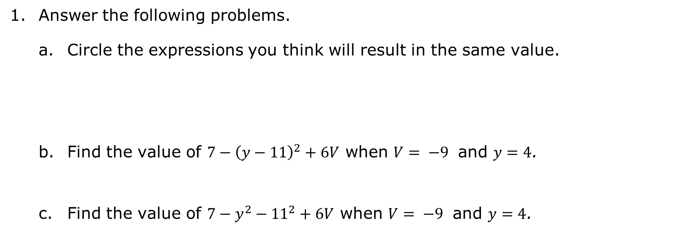
11.2.5 Your Turn!
Answer the following problems.
Circle the expressions you think will result in the same value.
Find the value of $7−{\left(y−11\right)}^{2}+6V$ when $V= −9$ and $y=4$.
Find the value of $7−y^{2}−{11}^{2}+6V$ when $V= −9$ and $y=4$.
$$7−{\left(y−11\right)}^{2}+6V$$ | $$7−y^{2}−{11}^{2}+6V$$ | $$7−y^{2}+{11}^{2}+6V$$
volume 2, pg. 250

Slide 24
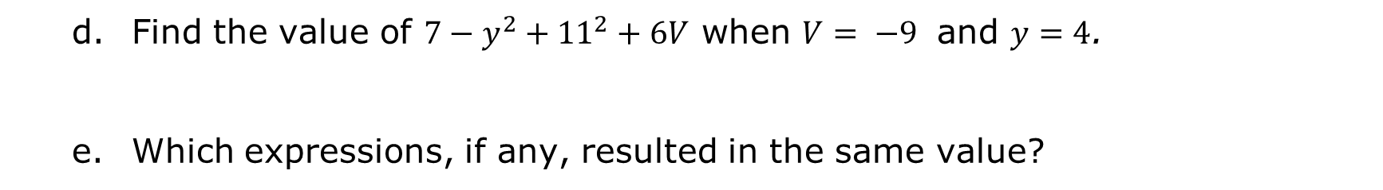
Find the value of $7−y^{2}+{11}^{2}+6V$ when $V= −9$ and $y=4$.
Which expressions, if any, resulted in the same value?
volume 2, pg. 250

Slide 25

Wrap-Up
volume 2, pg. 251

Slide 26
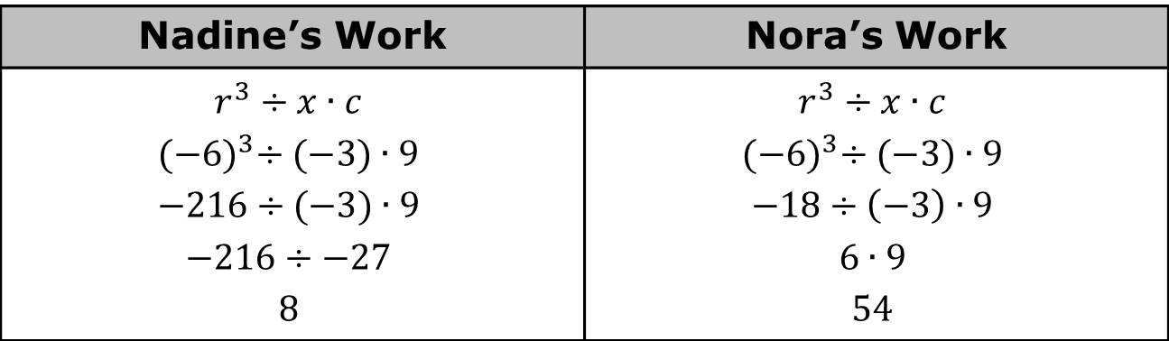
11.2.6 Wrap-Up: Error Analysis
Nadine and Nora evaluated the expression $r^{3}÷x∙c$ for $c=9$, $r=−6$and $x=−3$. Both students made errors in their work shown. Circle their errors.
Nadine’s Work | Nora’s Work
$$r^{3}÷x∙c$$ $${(−6)}^{3}÷(−3)∙9$$ $$−216÷(−3)∙9$$ $$−216÷−27$$ $$8$$ | $$r^{3}÷x∙c$$ $${(−6)}^{3}÷(−3)∙9$$ $$−18÷\left(−3\right)∙9$$ $$6∙9$$ $$54$$
volume 2, pg. 251

Slide 27
Write a short explanation to each student to explain the mistake and what she needs to remember about evaluating expressions in the future.
To Nadine: | To Nora:
volume 2, pg. 251

